Slide 1
Analyzing
NHANES
Survey Data
Udit Choudhary
Spring 2020 Data 606 : Capstone in Data Science

Slide 2
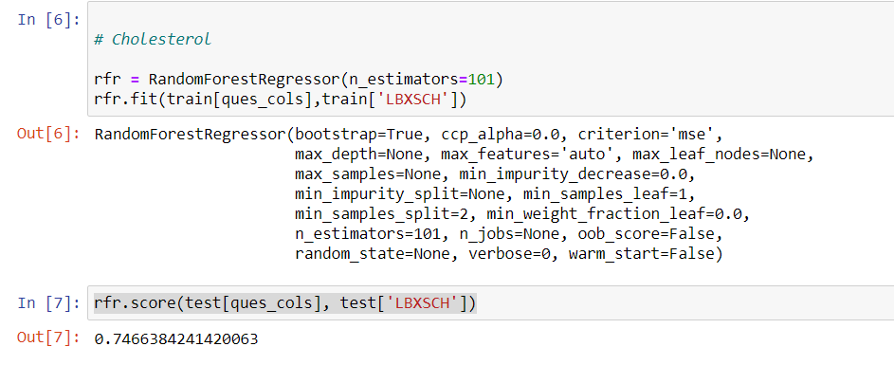
Prediction Model for Cholesterol

Slide 3
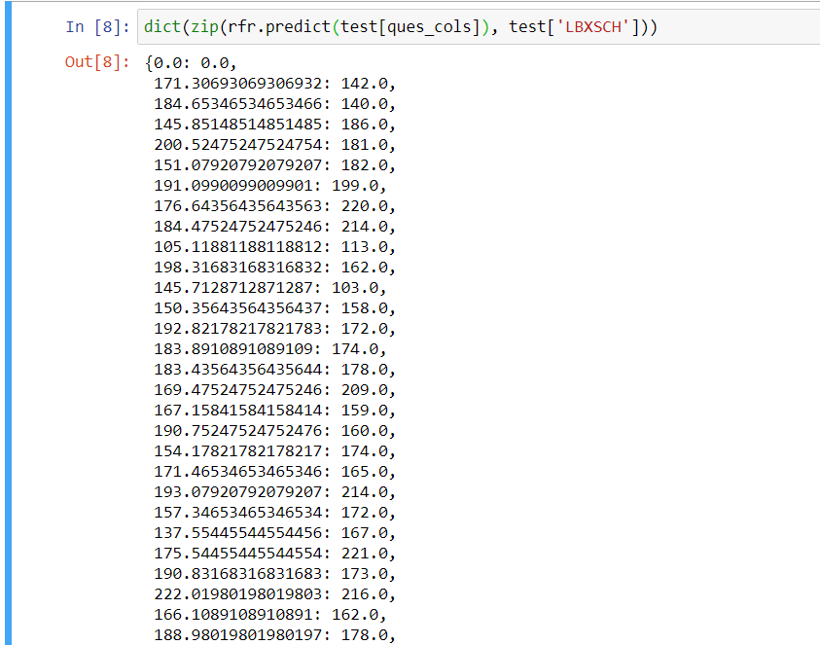
Predicted vs Actual (Cholesterol)

Slide 4
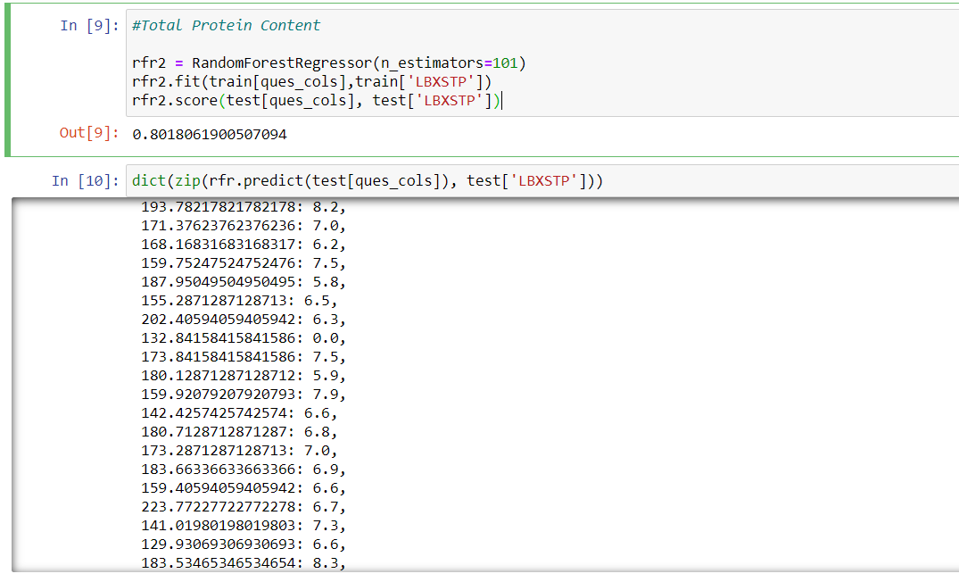
Prediction Model for Protein Content

Slide 5
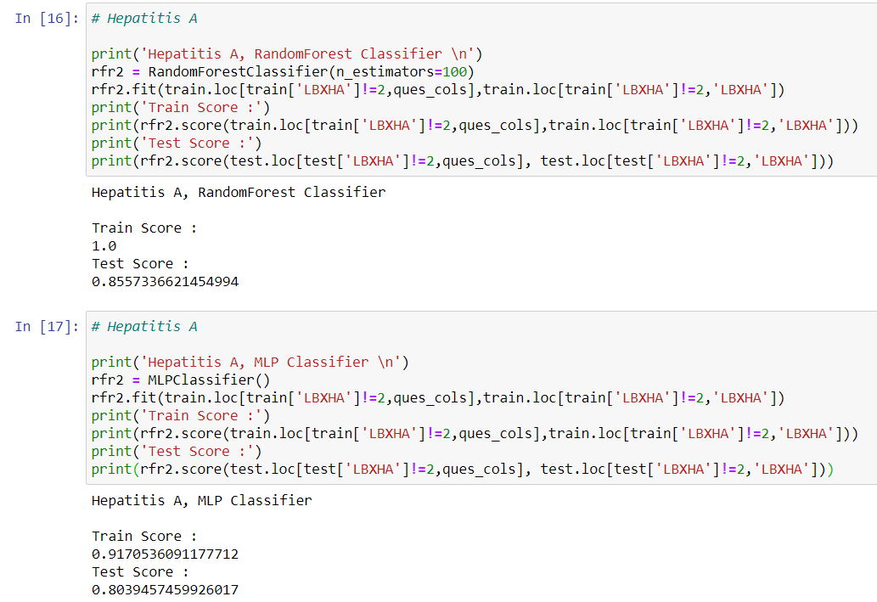
Prediction Model for Hepatitis

Slide 6
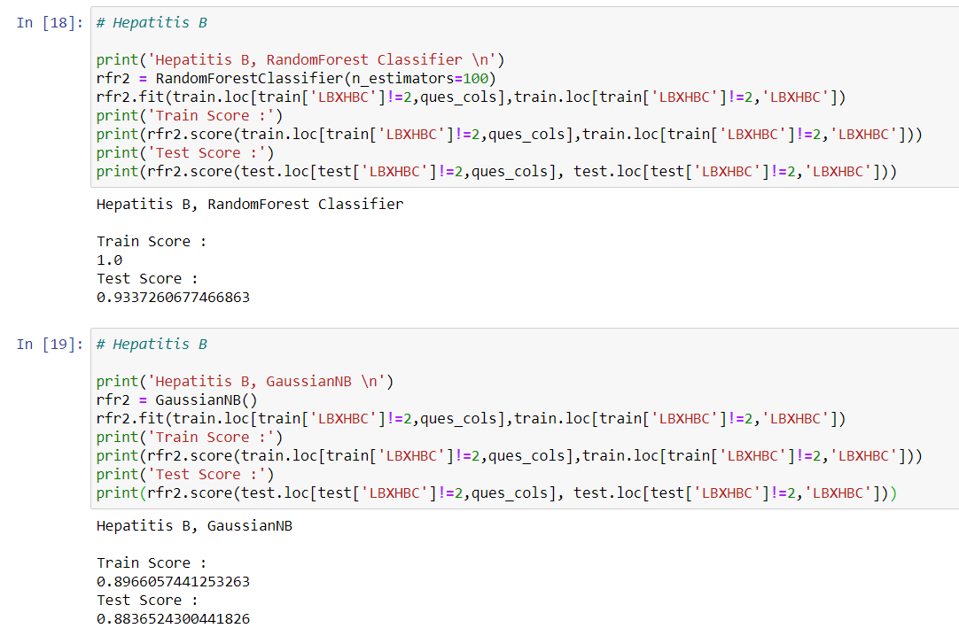

Slide 7
Confusion Matrix
(Hepatitis B) (MLP Classifier)
 | Predicted Positive | Predicted Negative
True Positive | 484 | 36
True Negative | 26 | 86

Slide 8
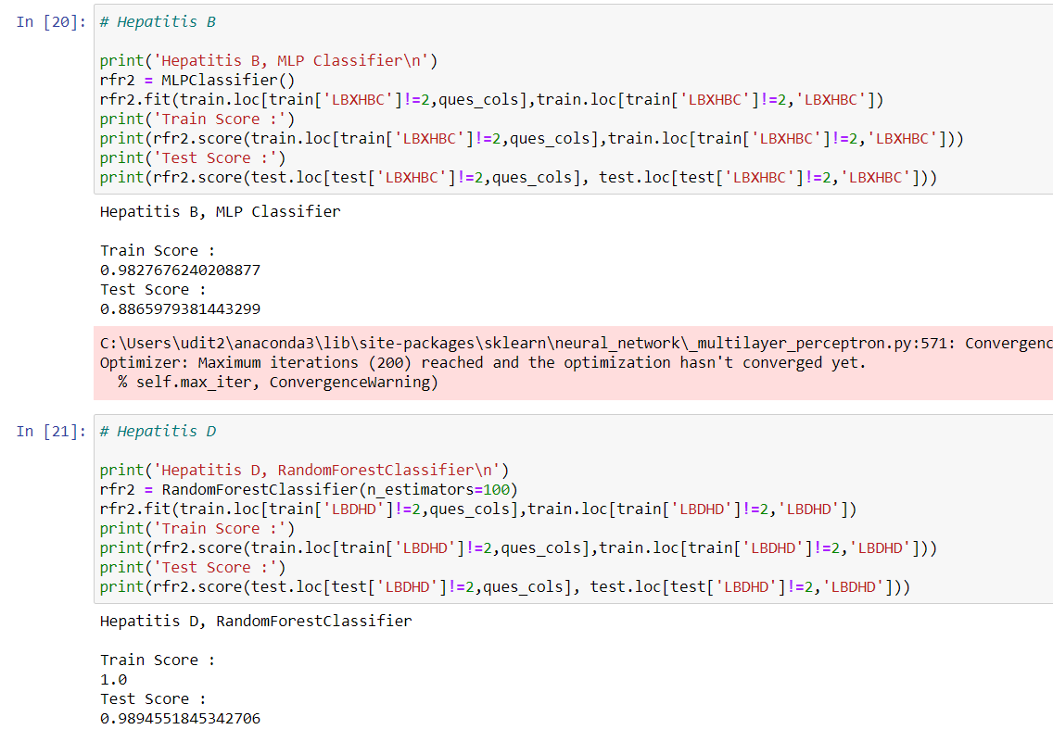

Slide 9
